Slide 1





Problem solution: example problem
Give 2 laptops, find out the best of them.
HP PAVILION 14 N237TU
ACER ASPIRE E1 470G

Slide 2

Problem solution
Determine 5 types of laptop’s hardware which are the most customer will be interested in when choosing a laptop.
Chipset (CPU)
Graphic card (VGA)
Memory (RAM)
Hard disk (HDD)
Screen solution
http://bit.ly/cps-survey-summary

Slide 3
Problem solution
Chipset (CPU)
Graphic card (VGA)
Memory (RAM)
Hard disk (HDD)
Screen solution
Price
Suggest for user
make decision
Score

Slide 4
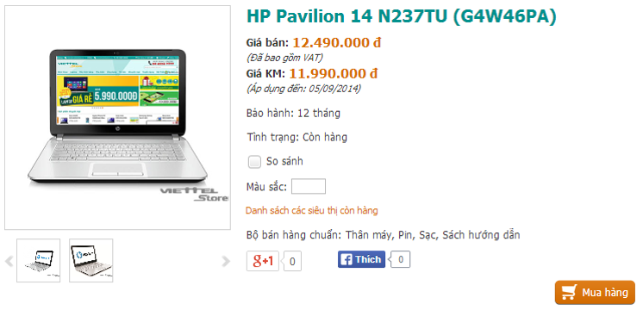
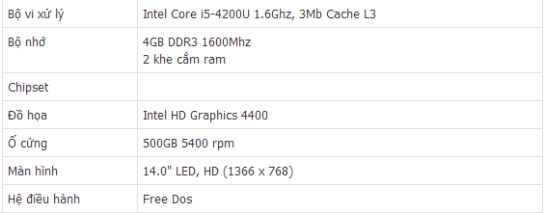



Problem solution: collect data
Laptops
viettelstore.vn
Notes:
Tách thành 2 slide

Slide 5
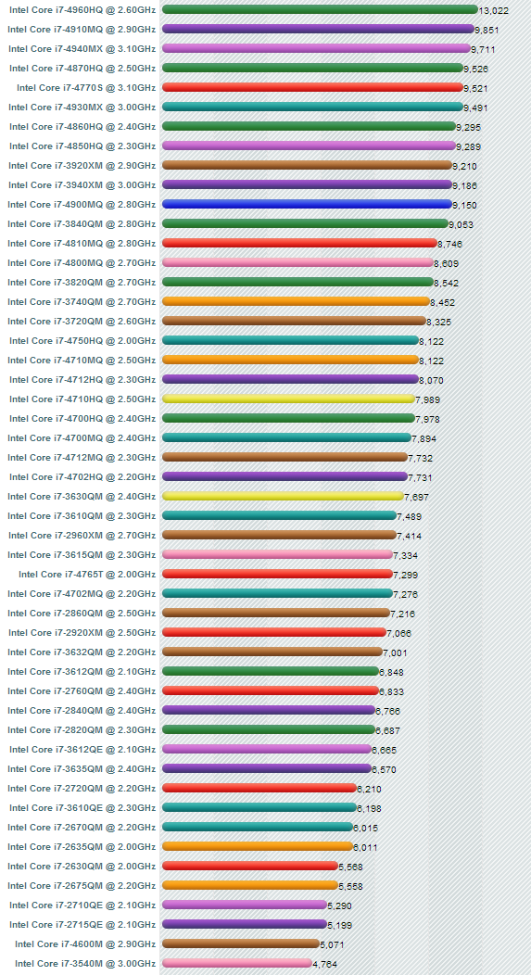
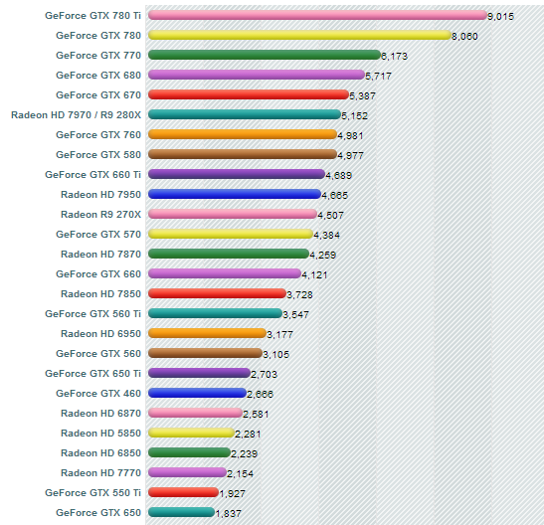

Problem solution: collect data
Laptop’s Hardwares
cpubenchmark.net
videocardbenchmark.net
Notes:
Tách thành 2 slide

Slide 6

Problem solution: collect data
Intel Core i5-4200U

Slide 7

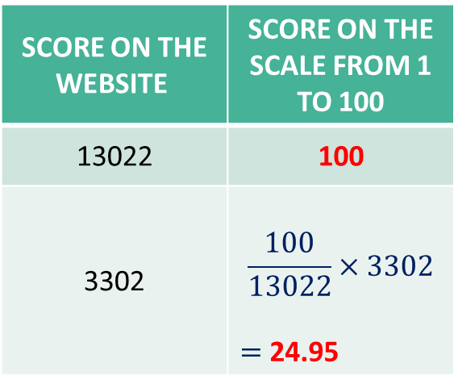
Problem solution: reduce score
Laptop’s Hardwares
13.022
Score on the website | Score on the scale from 1 to 100
13022 | 100
3302 | $$\frac{100}{13022}×3302$$ $=$ 24.95
3.302
Notes:
Tách thành 2 slide

Slide 8

Problem solution: reduce score
Hardware’s score
on the scale
from 1 to 100
 | HP PAVILION 14 N237TU | ACER ASPIRE E1 470G
Chipset (CPU) | 24.95 | 17.38
Graphic card (VGA) | 3.30 | 5.88
Memory (RAM) | 25 | 12.5
Hard disk (HDD) | 12.5 | 12.5
Screen solution | 80.92 | 80.92

Slide 9
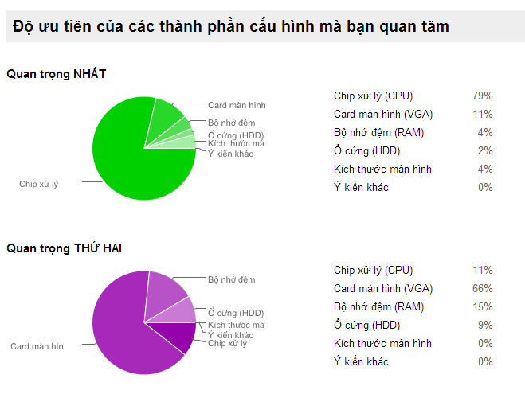
Problem solution: priority coefficient
http://bit.ly/cps-survey-summary

Slide 10
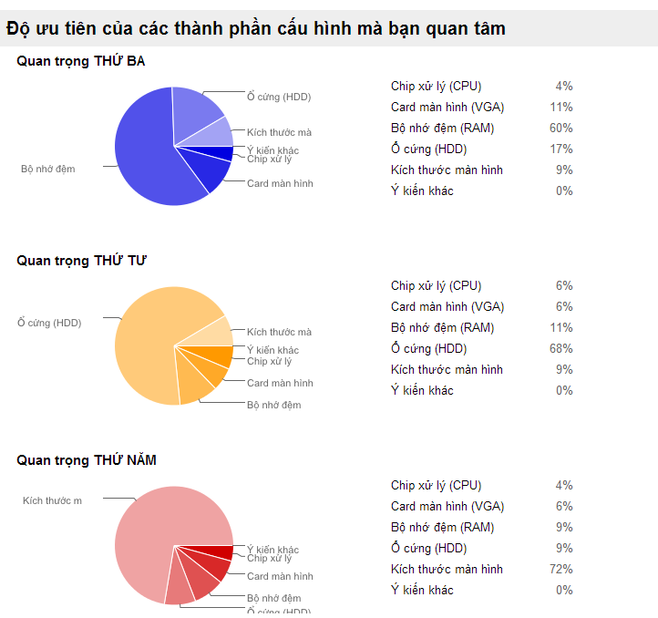
Problem solution: priority coefficient
http://bit.ly/cps-survey-summary

Slide 11
Problem solution: calculate product’s score
Hardware’s name | Score
Chipset (CPU) | c
Graphic card (VGA) | v
Memory (RAM) | r
Hard disk (HDD) | h
Screen solution | s
☞

Slide 12
Problem solution: calculate product’s score
HP PAVILION 14 N237TU
ACER ASPIRE E1 470G

Slide 13

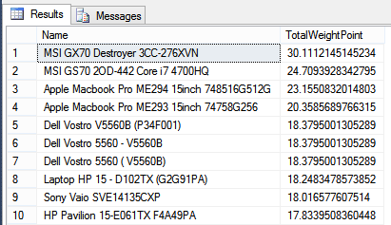
Problem solution: reduce score
Get highest product’s score in database

Slide 14
Problem solution: reduce score
 | HP PAVILION 14 N237TU | ACER ASPIRE E1 470G
Product’s score | 12.86 | 11.26
Highest product’s score | 30.11 | 30.11

Slide 15
Problem solution: reduce score
➢ Reduce hardware’s score on the scale from 1 to 100
➢ Define:
P = Highest product’s score.
p =
Product’s score which will be reduced.
p’ = Product’s score on the scale from 1 to 100.
☞

Slide 16
Problem solution: reduce score
Product’s score
on the scale
from 1 to 100
 | HP PAVILION 14 N237TU | ACER ASPIRE E1 470G
Product’s score | 12.86 | 11.26
Highest score in the database | 30.11 | 30.11
Score on the scale from 1 to 100

Slide 17

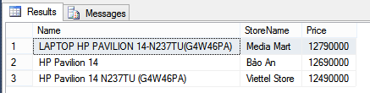
Problem solution: calculate price/score
Get all product’s price from stores of a product.
Max Price
Min Price

Slide 18
Problem solution: calculate price/score
➢ Define:
P_{min/max} = Min/Max price of a product
S =
Product’s score
R_{min/max} = Min/Max price for each product’s score
☞

Slide 19
Problem solution: calculate price/score
 | HP PAVILION 14 N237TU | ACER ASPIRE E1 470G
Product’s min price (VNĐ) | 12.490.000 | 8.990.000
Product’s max price (VNĐ) | 12.790.000 | 8.990.000
Product’s score | 12.86 | 11.26
Min Price for each score (VNĐ)
Max Price for each score (VNĐ)
Price for each score

Slide 20

Problem solution: compare
Product’s score on the scale from 1 to 100
Min/Max price of each product’s score

